Slide 1

Sprint 1
Batch- Capgemini-73-Testing-B5-API
(Group 5)
Project On:-

Slide 2

Project Overview
1
Asian Paints application is intended for users to search for different Paints & colours, Textures and Wall Coverings to paint their house, office etc.
The user can search for different colours, wallpapers and can shop for it.
The user can even view and book a contractor based on their locality by entering pin code.

Slide 3
Individual module assigned.
1.HOME PAGE:
Validate the headers, Top Menu, page title and information present on the page.
b. User can login through Mobile number.
2.PAINTS & TEXTURES TAB
a) Interior exterior and waterproofing
b) Paint budget calculator
c) Find a contractor
3.IDEAS
a) User can get suggestion\ideas for its painting requirements.
b) User can request for a free site evaluation by an Asian Paints Safe Painting Service expert. c. Select Hotel for booking
4.SHOP:-
Wallpaper, wall stickers & colour selection tools
Add to cart & Payment
Assigned to :
Muskan Mourya
Assigned to :
a)Pooja Parandwal
b)Mayuri rokade
c)Pooja singh
Assigned to :
Manasa K G
Assigned to :
a)Sukanya Pucheti
b)M Monisha

Slide 4
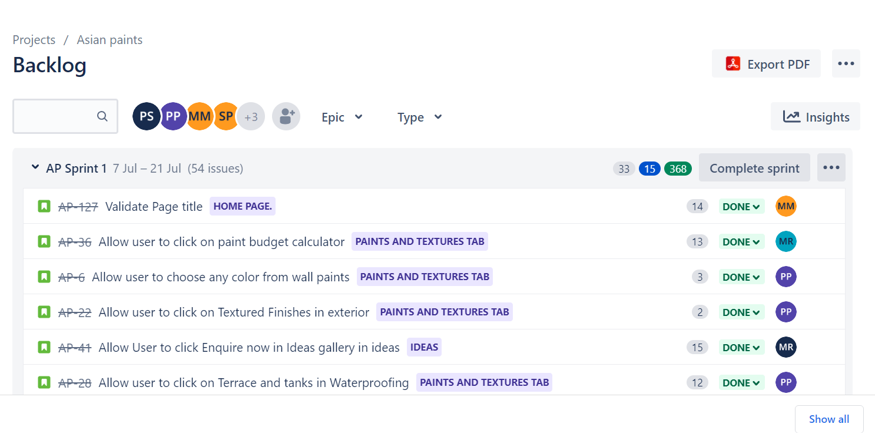
Sprint 1 (day-1)
Project Management Activity: Product Owner
Created User story on JIRA
Based upon functionality by understanding requirement.
Assigning priority.
Assigning the stories to team members
All task are done on SCRUM template of JIRA.

Slide 5
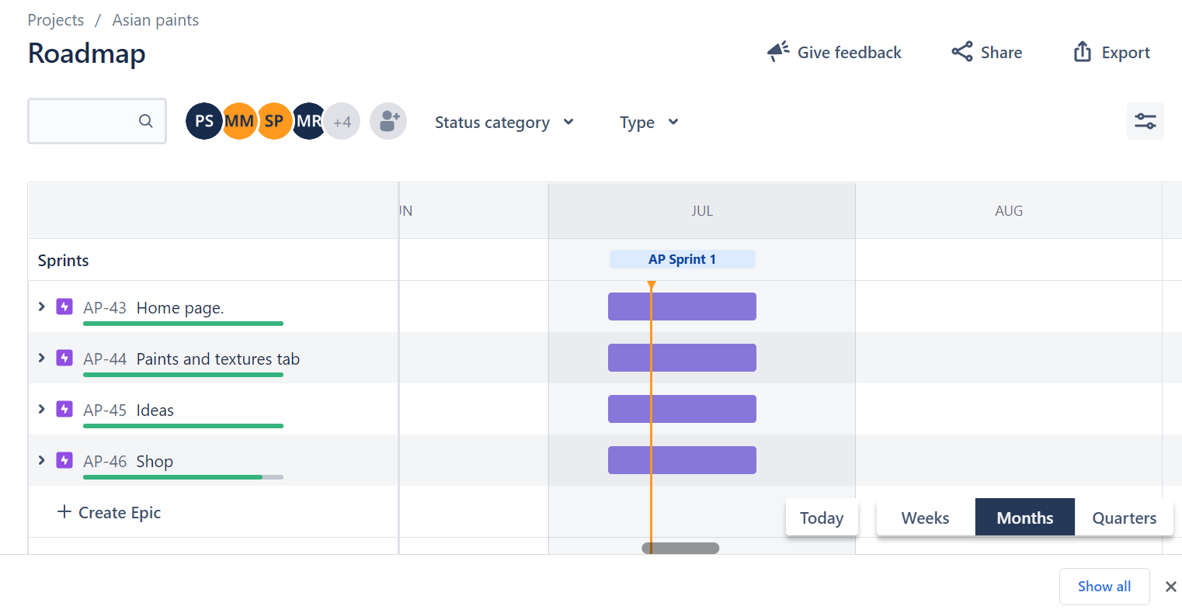
Sprint 1 (day-2)
JIRA Task and Test Design : Dev Team
Assigned story point or time required to accomplish the story/Task.
Categorize user stories in to Epic, User Stories, Tasks & Subtasks
Add group members in the Project on JIRA.
Create Manual Test Scenarios
Test scenarios
Test Case design
Test case writing on Zephyr
Notes:
1.

Slide 6
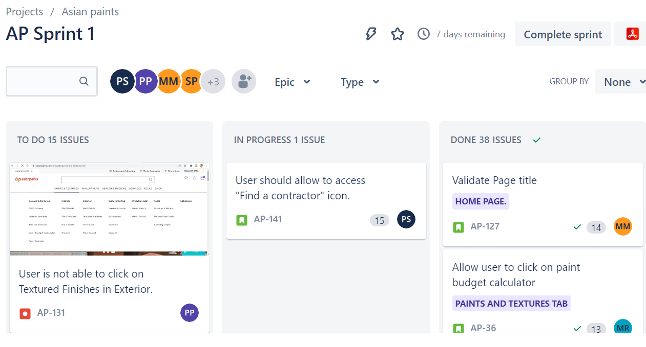
Sprint 1 (day-3)
Scrum Team activities : Dev Team
Create scrum based sprints
Create Sprint backlog (select the stories for the particular Sprint)
Create Sprint board (To do , in process, Done)

Slide 7
Sprint 1 (day-4)
Scrum Team Activity : Scrum Team (PO, SM, DT)
Create Task / Deliverables:
Defect reporting
Traceability Matrix
Test summary report
Plan for release
Generate Agile report relevant to scrum project

Slide 8
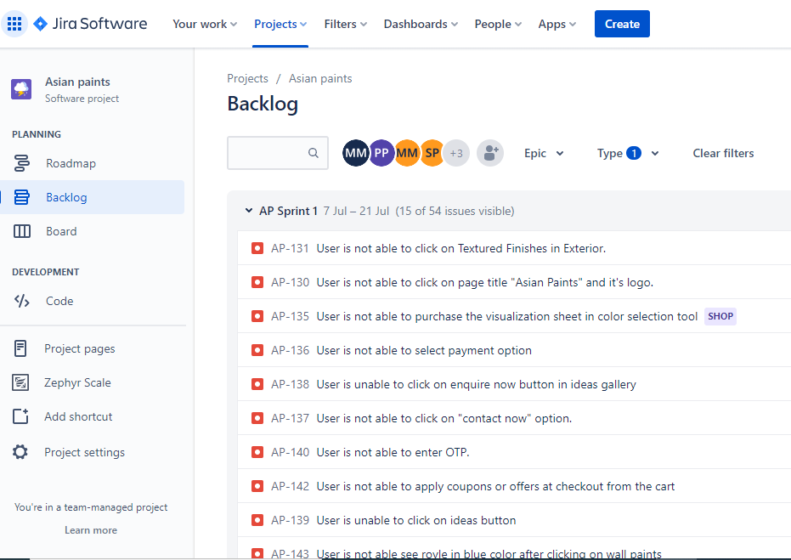
Defect Reporting

Slide 9
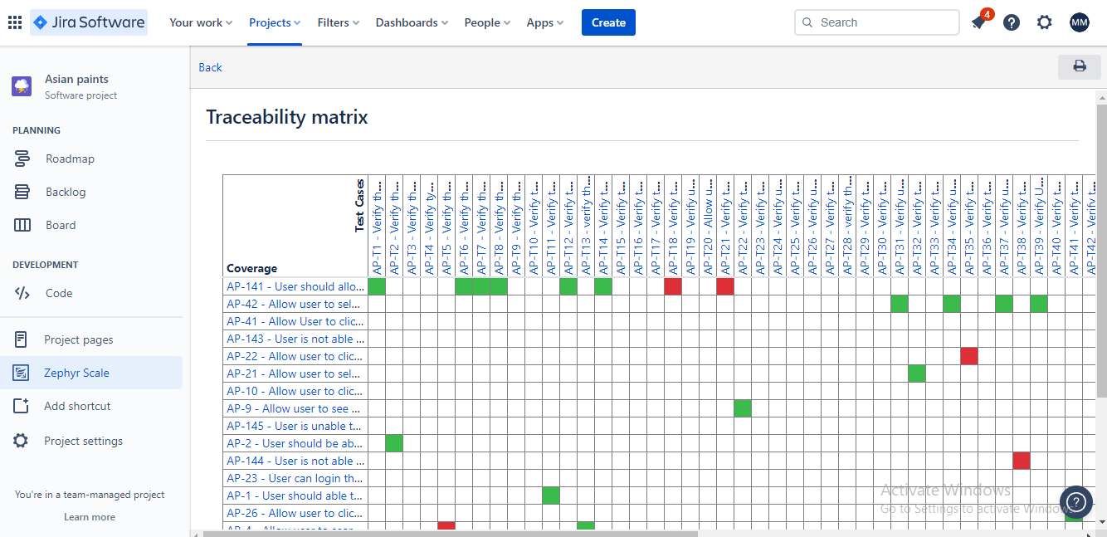
Traceability matrix

Slide 10
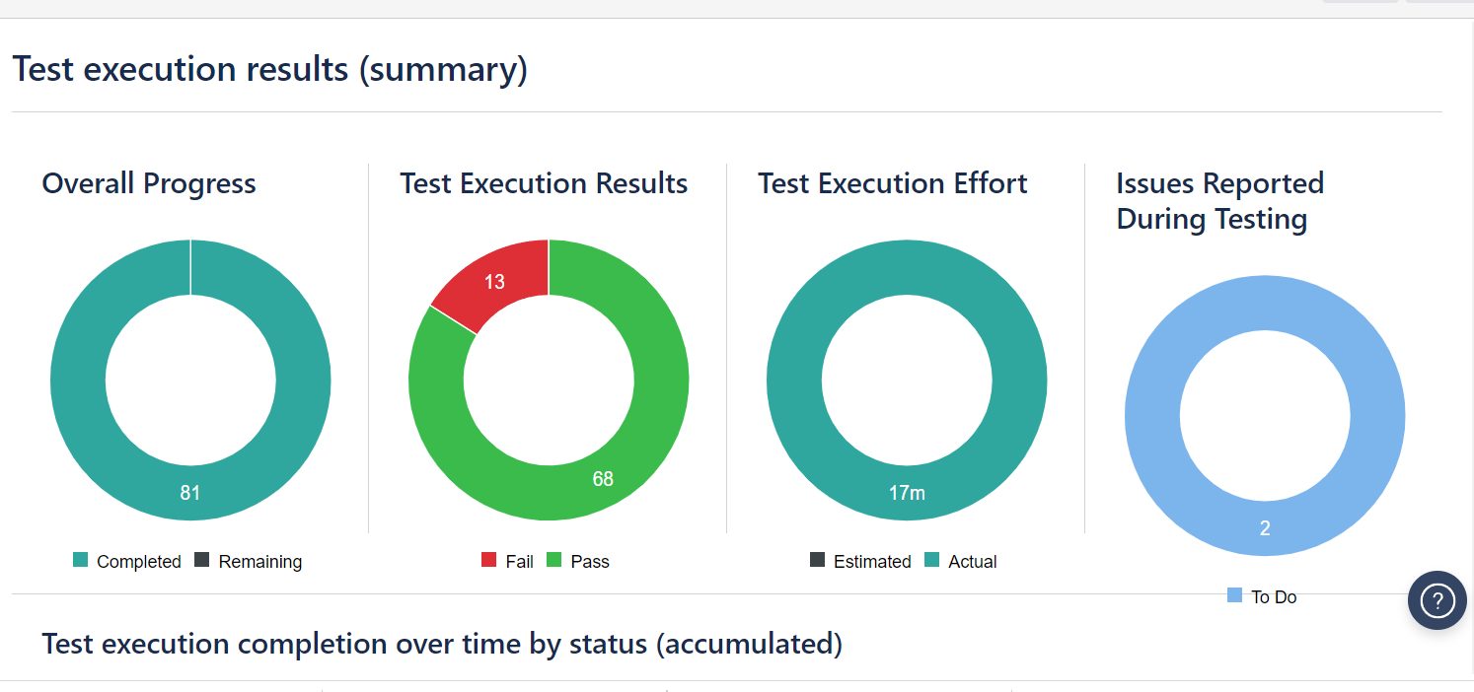
Test Summary report:

Slide 11
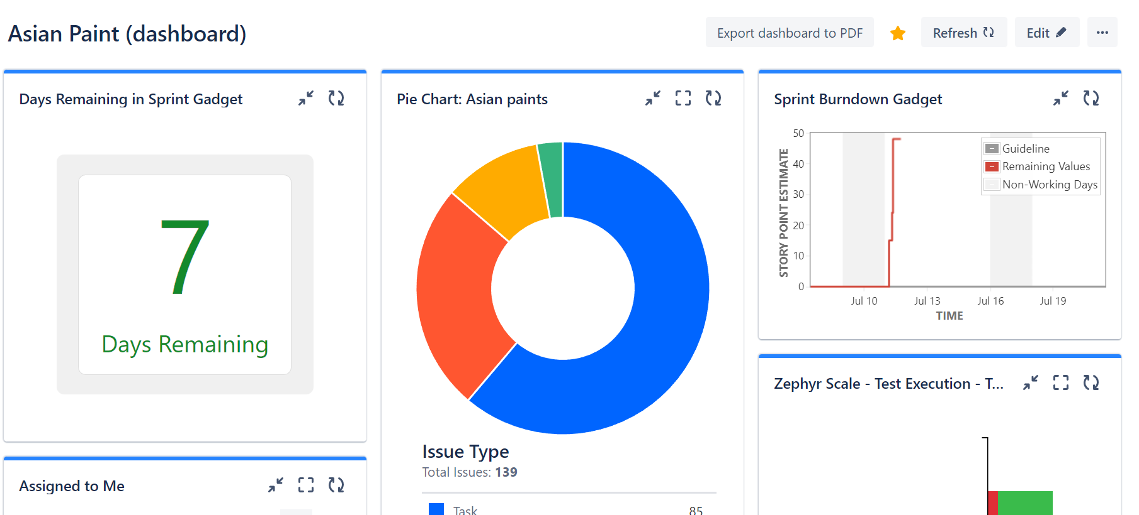
Dashboard added plugins:-
Pie Chart
Test execution scorecard by tester
Test execution score card by the test cycle
Test execution results (overall)
Days remaining in sprint gadget
Burn down chart

Slide 12
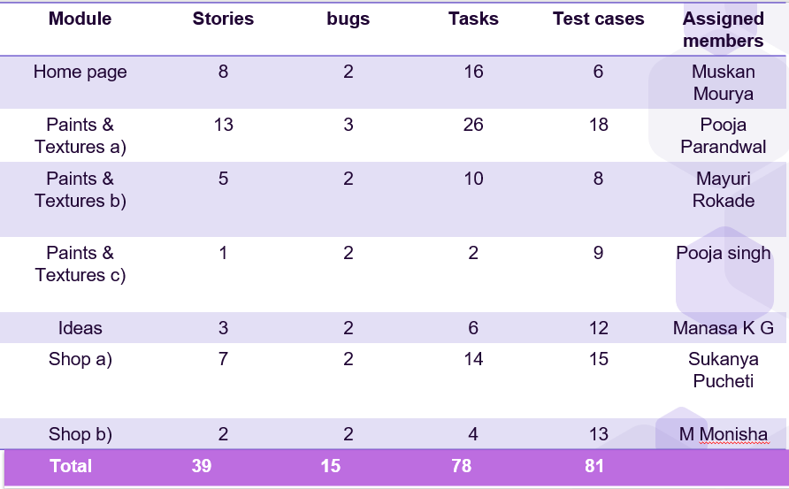
Overall Summary

Slide 13

Learning from JIRA
Story creation
Epic creation
Working with zephyr scale
Test case Creation
Test cycle Creation
Test execution
Traceability Matrix
dashboard creation

Slide 14

Challenges Faced during JIRA Sprint
Managing Dependencies
Complex workflows and too many required fields
The many views confuse users
Excel is still required; Jira cannot provide us everything we need
It takes a lot of time to load pages

Slide 15

How did you overcome the challenge
Managing Dependencies is overcome by Bridging the communication gap among the teams
Properly Analysing and gaining knowledge about JIRA Workflow.
Added plugins such as Zephyr, Pdf extractor helps a lot
Plugins in Dashboard helps to be in track with the project

Slide 16

Important Link:
JIRA Link: https://capgeps.atlassian.net/jira/software/projects/AP/boards/3?assignee=62c26a0da7de1e7c7c2cd1a1&selectedIssue=AP-141
Git Link: https://github.com/muskanmourya/sprint1
Pdf extract of dashboard:

Slide 17
Thankyou

